Slide 2
UNIT 17
Stories for children
Lesson 2(1,2,3)

Slide 3
Table of Contents
Warm-up and Review
Look, listen and repeat.
Listen, point and say.
Let’s talk.
Fun corner and Wrap-up

Slide 4
CAR RACING
Click Here to Start
1
Notes:
- Children work in groups. One car stands for one group.
- Two children from each group will ask and give directions. If correct, their team car will move forward.

Slide 5
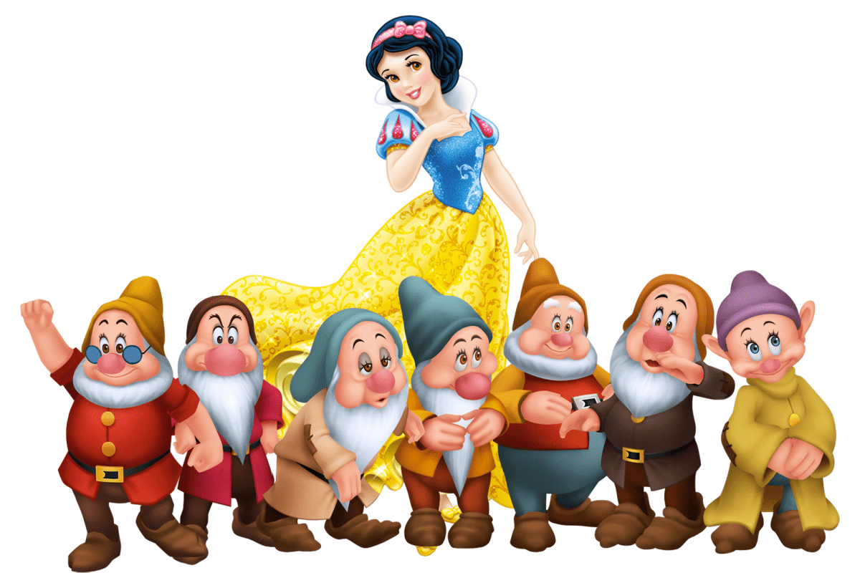
Who are the main characters in this story?
Snow White and the seven dwarfs

Slide 6
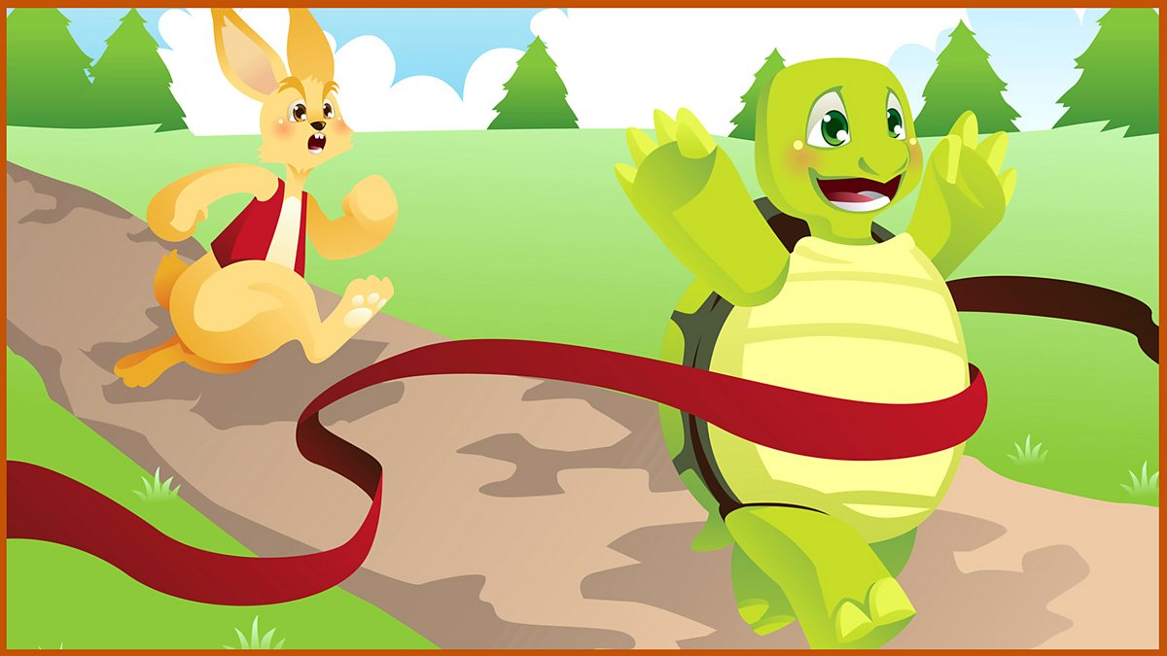
Who are the main characters in this story?
The tortoise and the hare

Slide 7
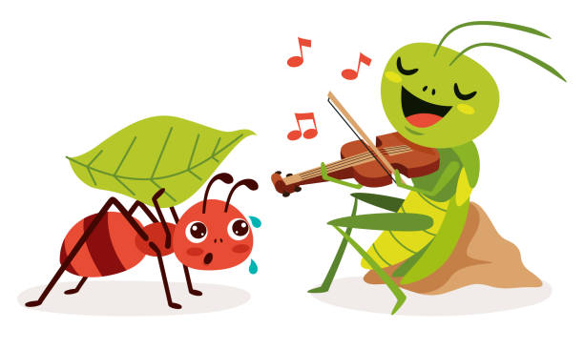
Who are the main characters in this story?
the ant and the grasshopper

Slide 8
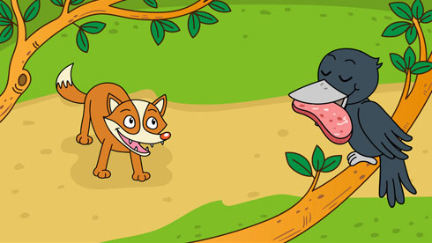
Who are the main characters in this story?
the fox and the crow

Slide 9
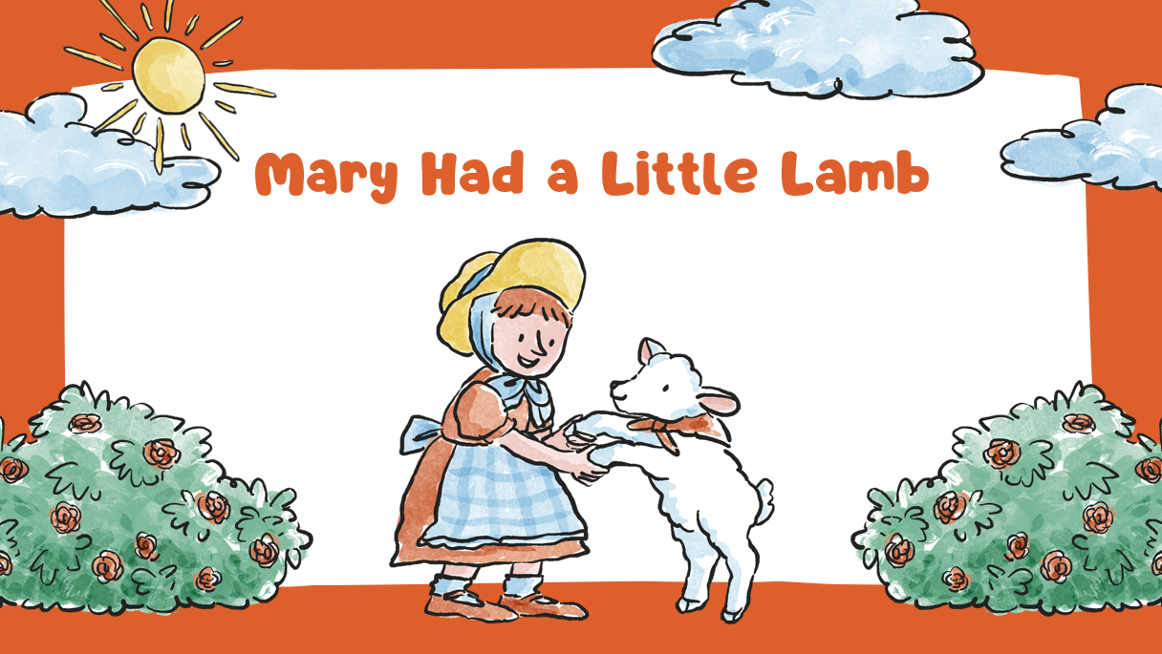
Who are the main characters in this story?
Mary and the lamb

Slide 10
1.Look, listen and repeat.

Slide 11
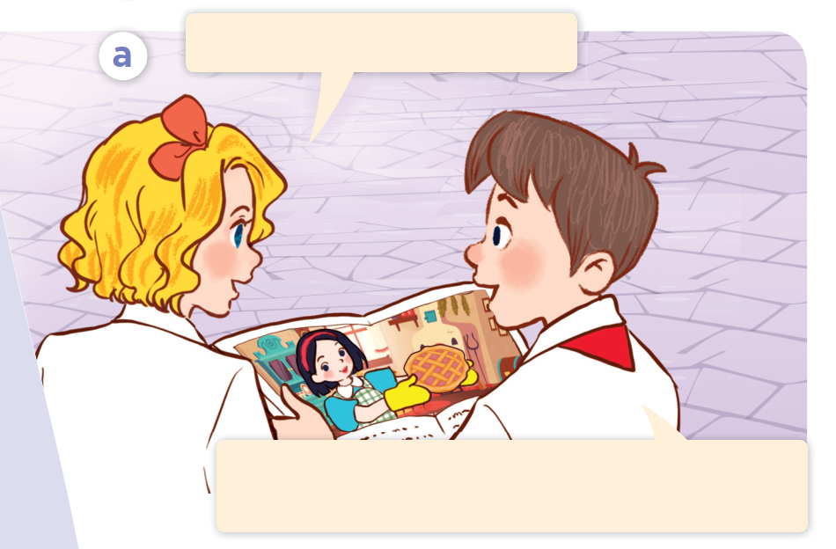
Look and say.

Slide 12
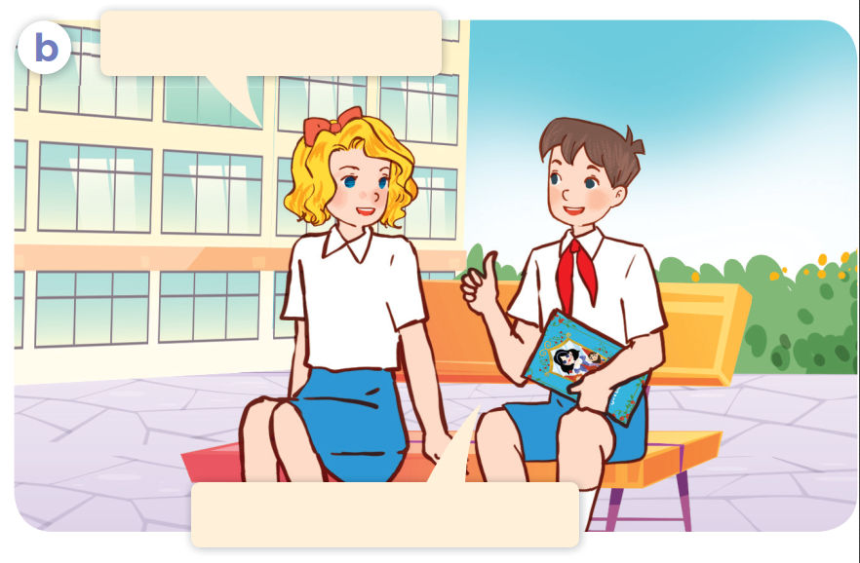
Look and say.

Slide 13
Listen and point.

Slide 14
Listen, point and repeat.
Do you like Snow White?
Yes, I do. She was kind. She cooked
meals every day for the seven dwarfs.

Slide 15
Listen, point and repeat.
How did she cook?
She cooked very well.

Slide 16
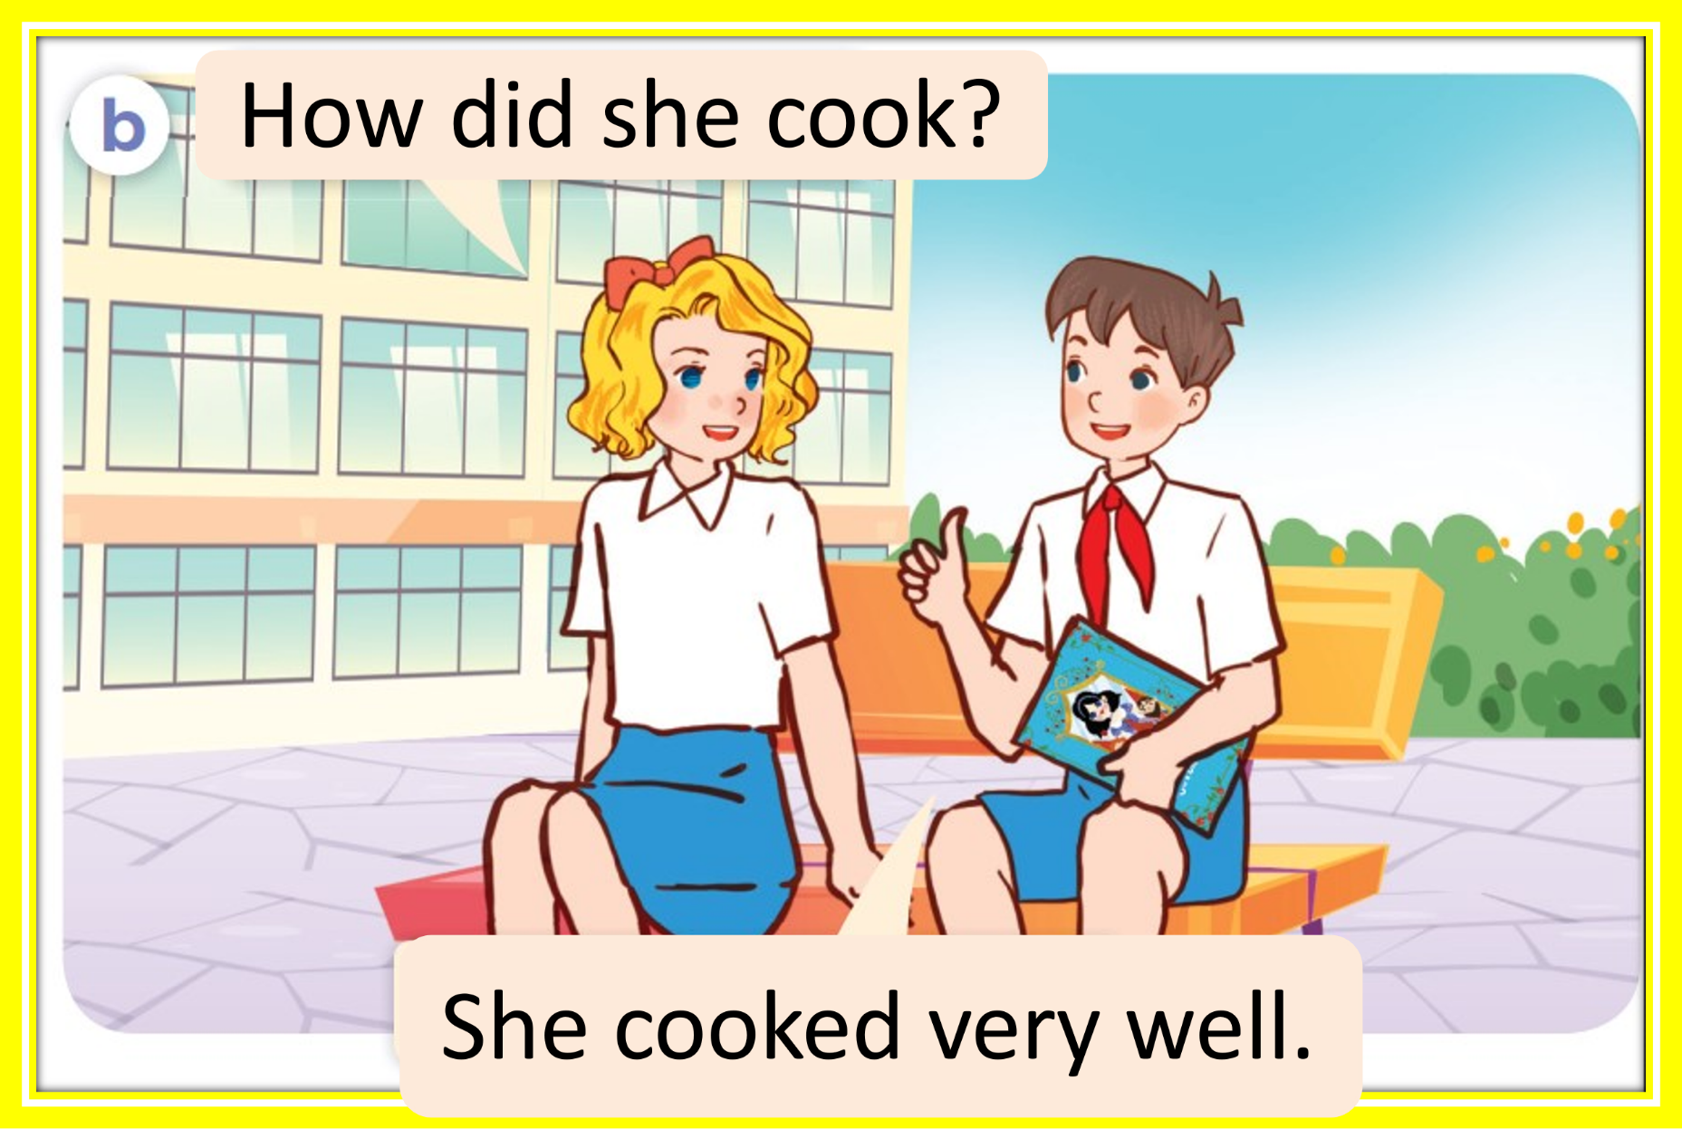
Look and answer.
Do you like Snow White?
Yes, I do. She was kind. She cooked
meals every day for the seven dwarfs.
Notes:
.

Slide 17
Listen and complete.
like
Do you _____Snow White?
cook
How did she ______?
She _______ very well.
cooked

Slide 18
2.Listen, point and say.

Slide 19
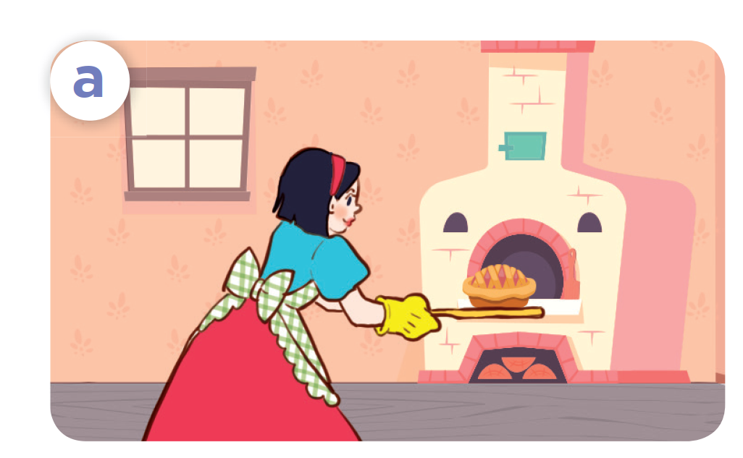
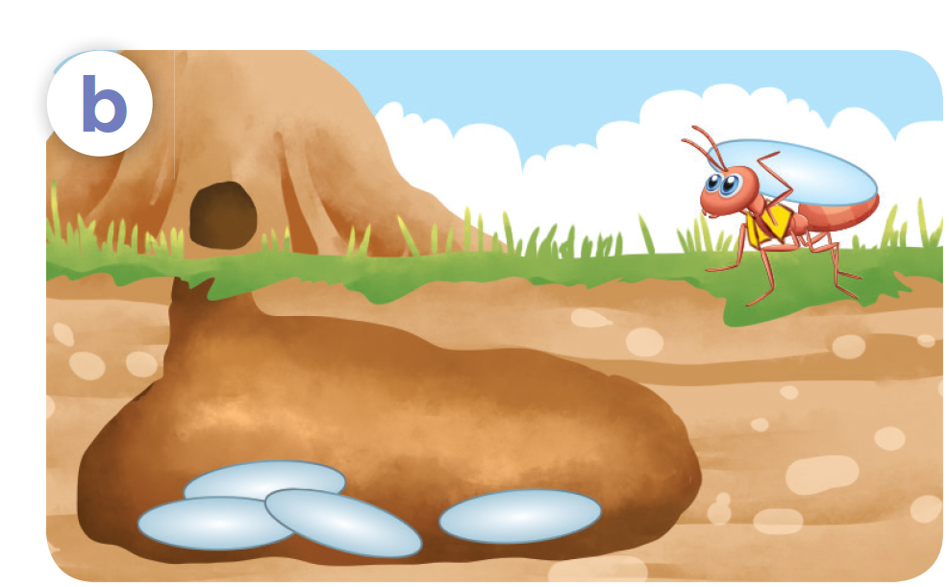
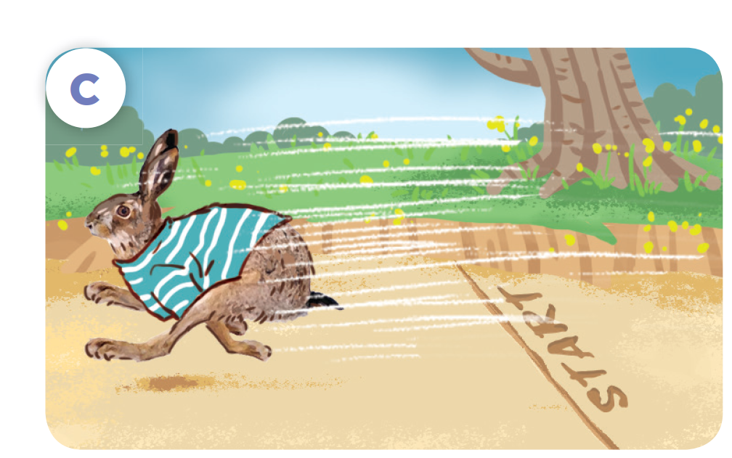
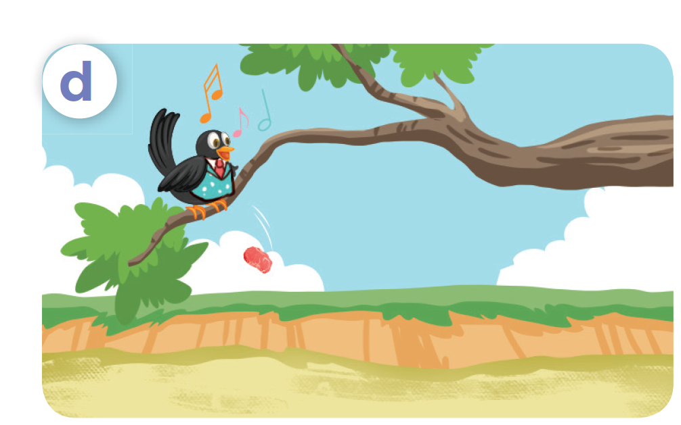
Look and say.
she / cook / cook well
he / work / work hard
he / run / run fast
he / sing / sing beautifully

Slide 20
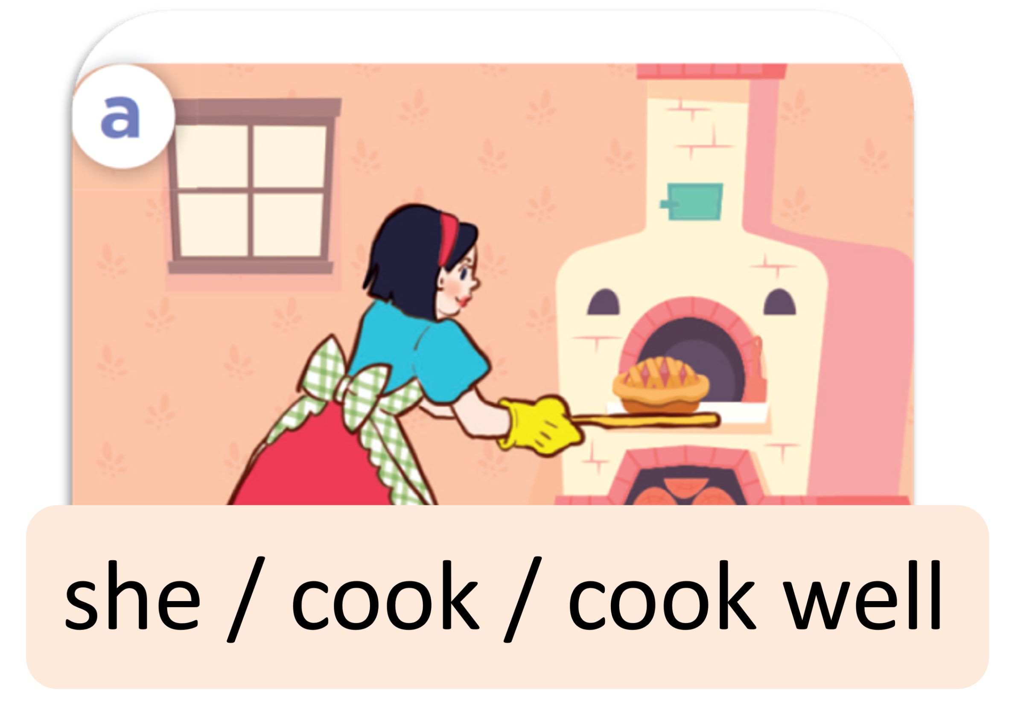
Listen and repeat.
she / cook / cook well

Slide 21
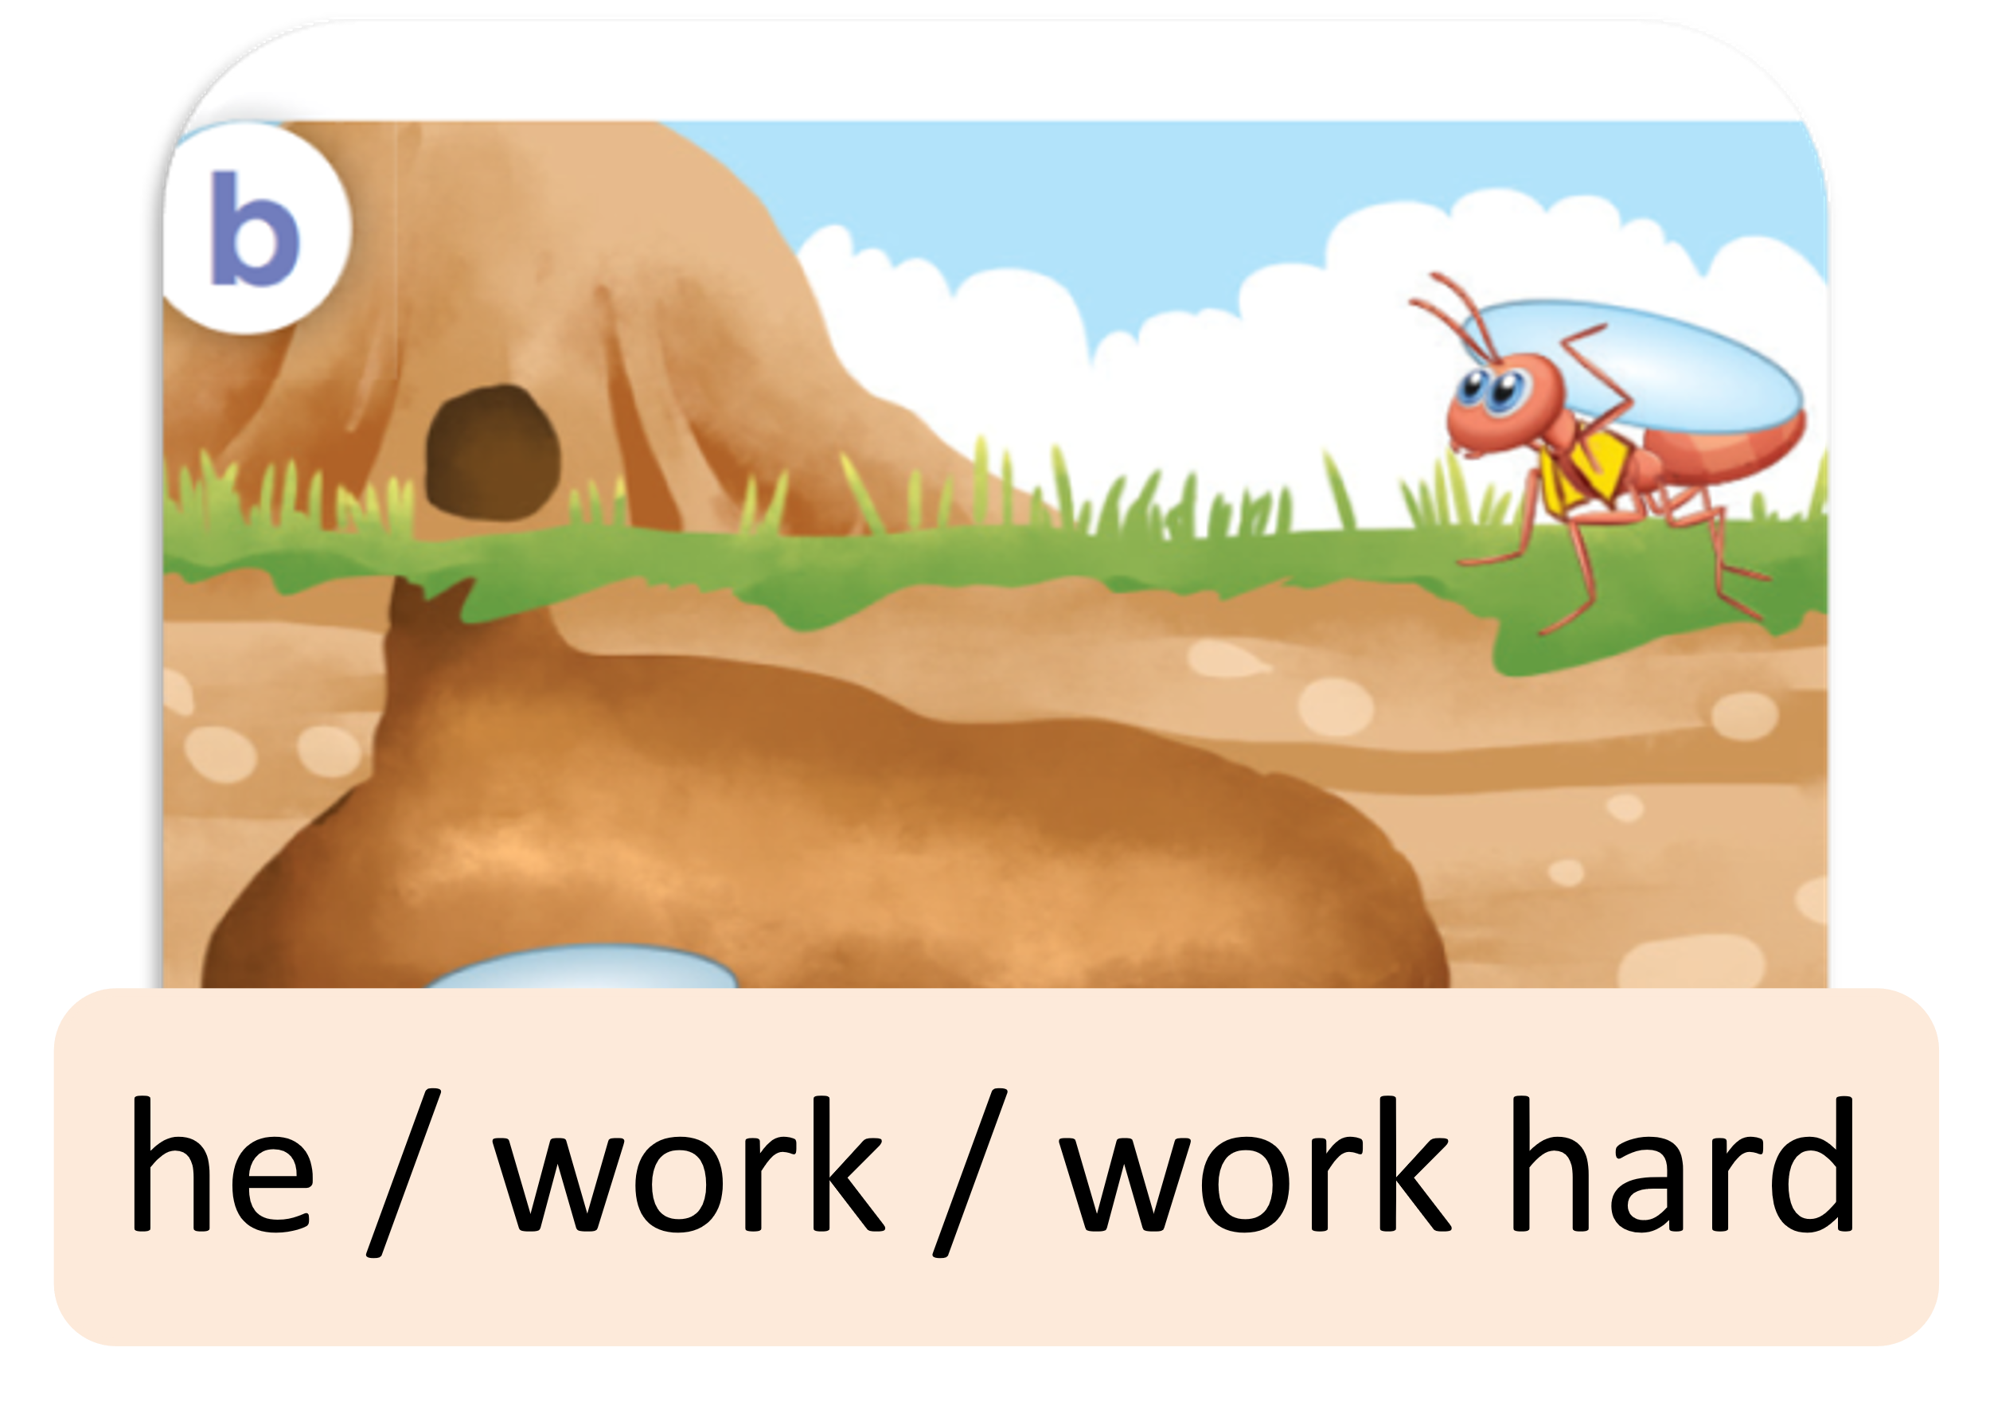
Listen and repeat.
he / work / work hard

Slide 22
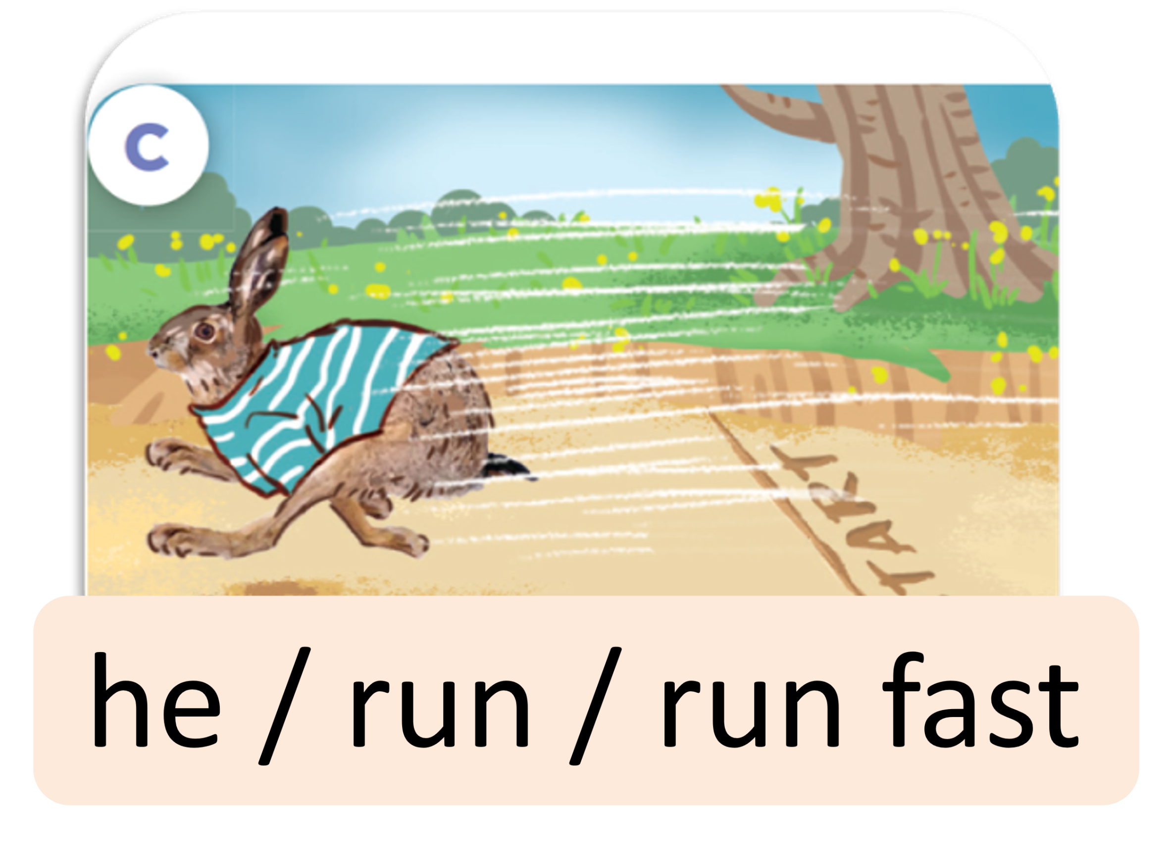
Listen and repeat.
he / run / run fast

Slide 23
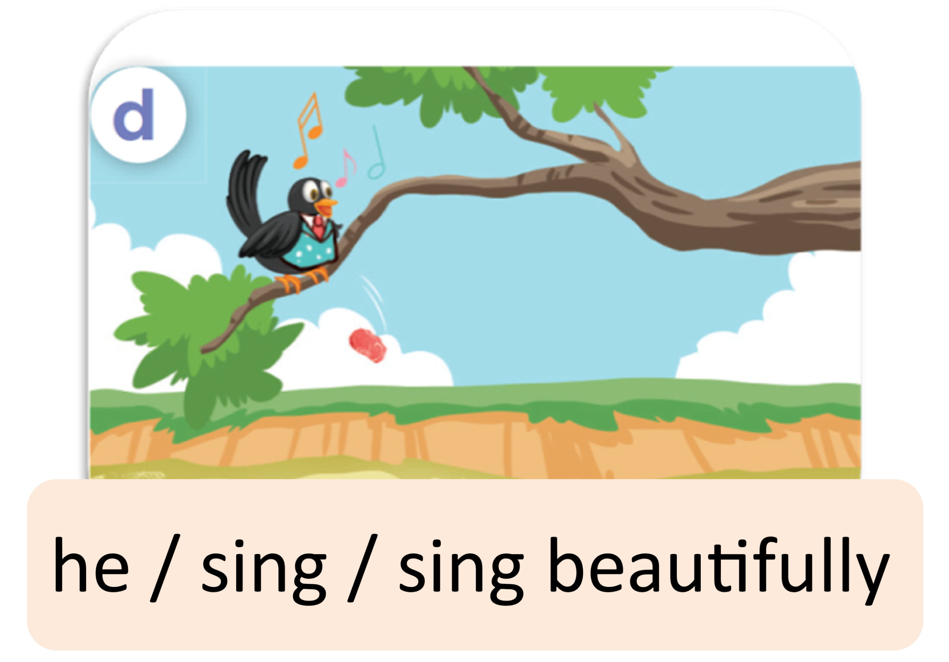
Listen and repeat.
he / sing / sing beautifully

Slide 24
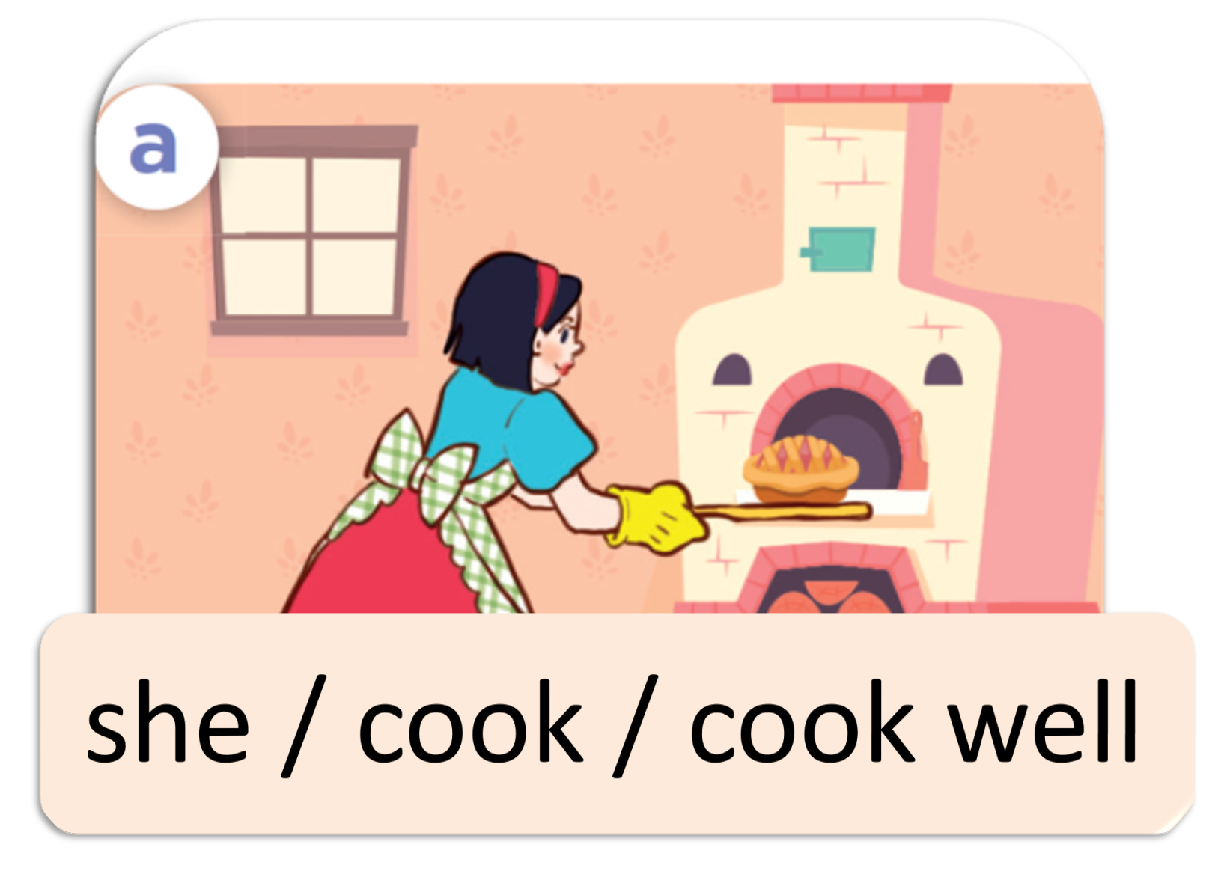
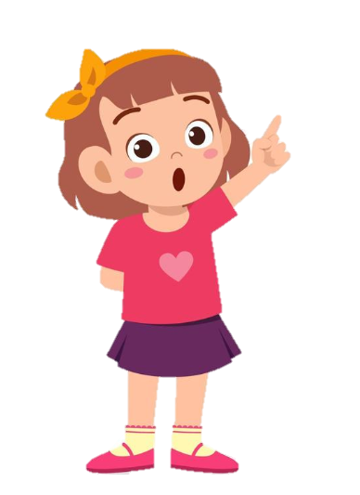
Listen, point and say.
She cooked well.
How did she cook?
she / cook / cook well

Slide 25
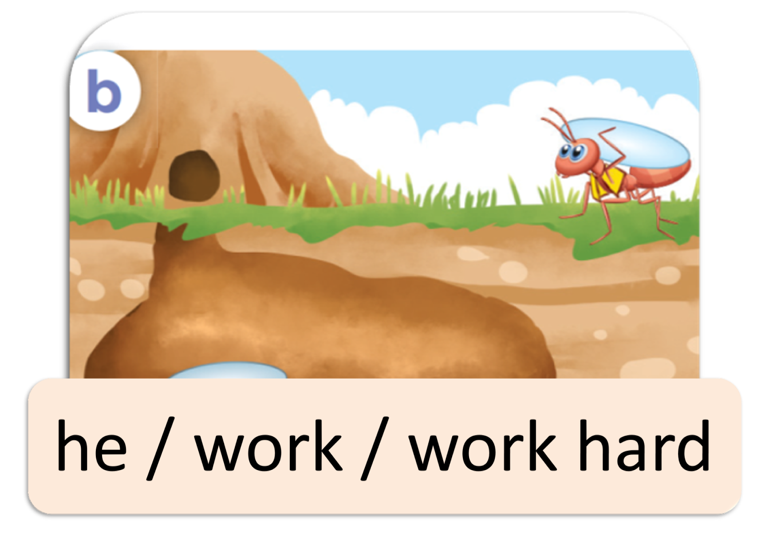
Listen, point and say.
He worked hard.
How did he work?
he / work / work hard

Slide 26
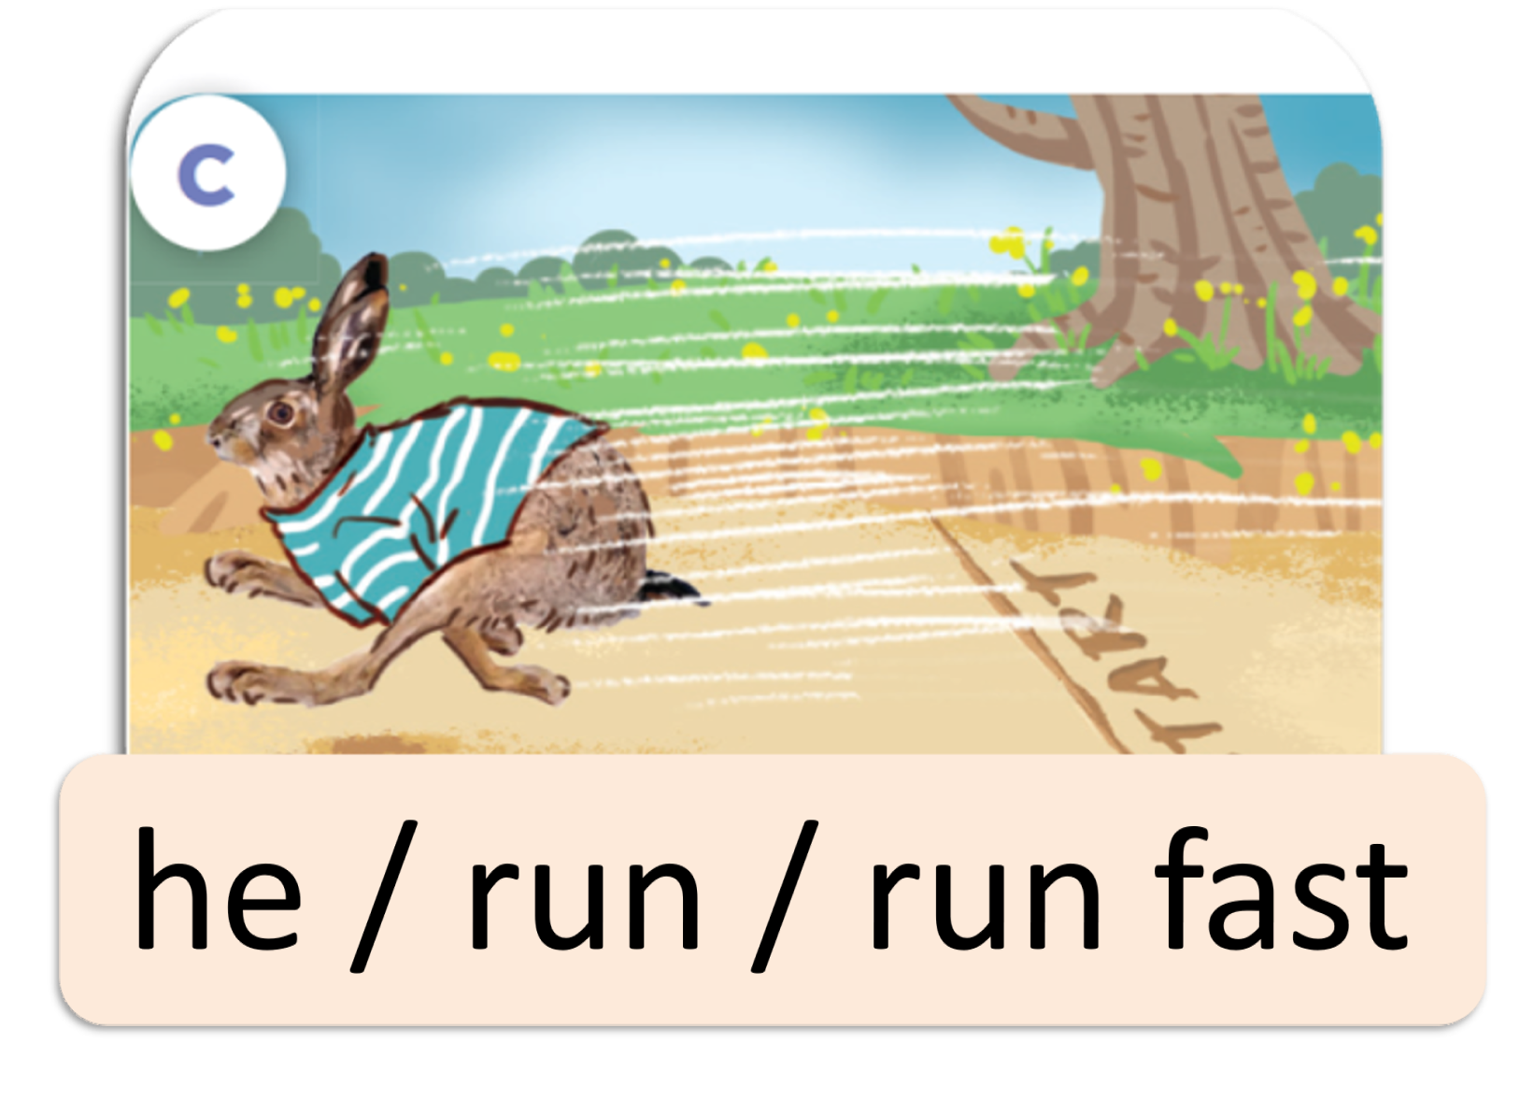
Listen, point and say.
He ran fast.
How did he run?
he / run / run fast

Slide 27
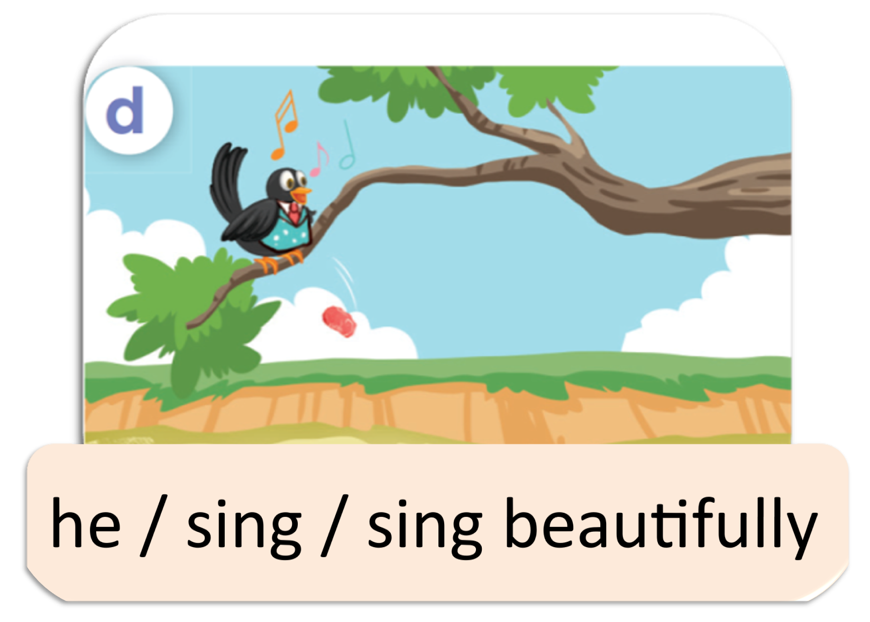
Listen, point and say.
He sang beautifully.
How did he sing?
he / sing / sing beautifully

Slide 28
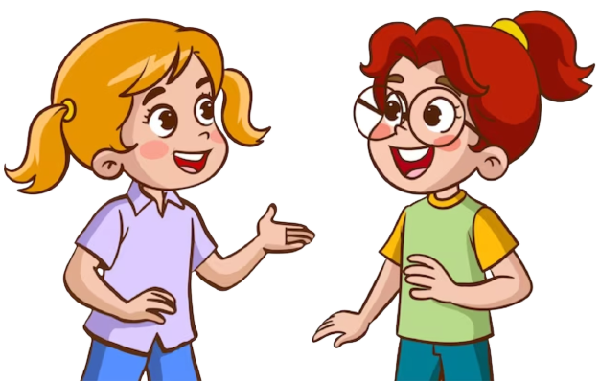
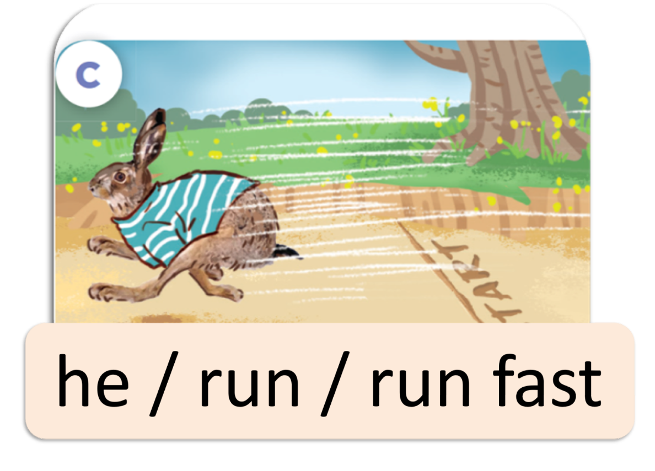
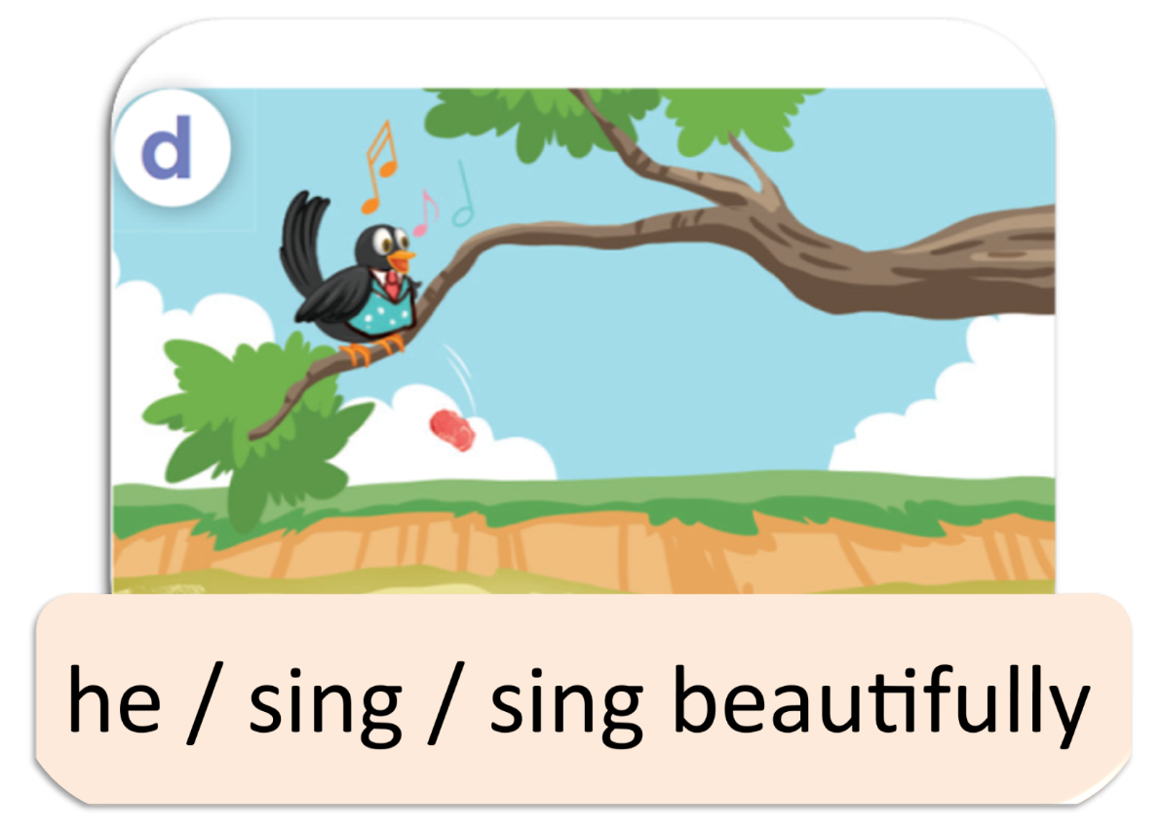
Listen, point and say.
she / cook / cook well
he / work / work hard
he / run / run fast
he / sing / sing beautifully

Slide 29
3.Let’s talk.

Slide 30
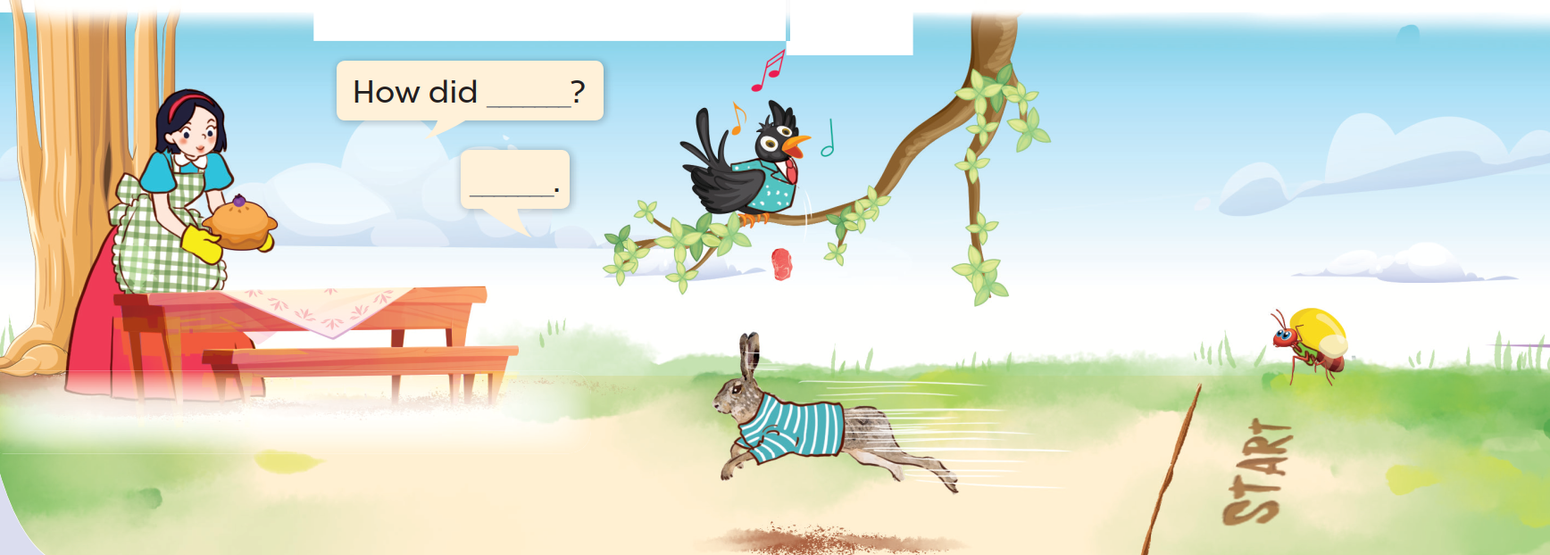
Look and say.

Slide 31
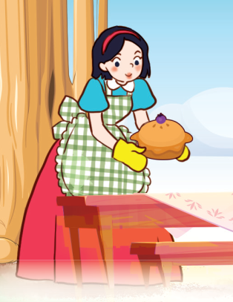
Look, read and answer.
She cooked well.
How did she cook?

Slide 32
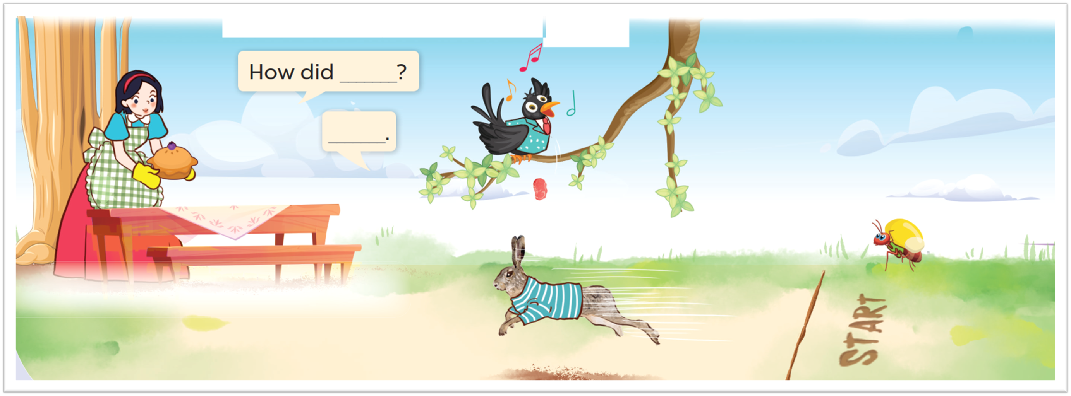
Ask and answer.

Slide 33
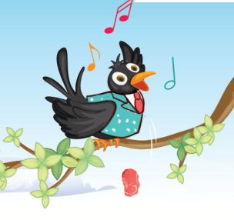
Look, read and answer.
He sang beautifully.
How did he sing?

Slide 34
Look and say.

Slide 35
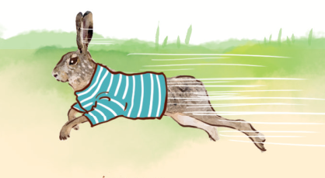
Look, read and answer.
He ran fast.
How did he run?

Slide 36
Look and say.

Slide 37
Look, read and answer.
He cooked hard.
How did he work?

Slide 38
4.Fun corner and Wrap-up

Slide 39
TREASURE HUNT

Slide 40
Hello Treasure Hunters!
We will be your captain today.

Slide 41
Listen carefully!
Notes:
Divide class into five groups.
Discuss the riddle within the group.
The first one to find the object inside the classroom will get points!

Slide 42
Are you ready?

Slide 43
Riddle 1
This is a story.
You can see the Fox in this story.
What is the name of this story?

Slide 44
Answer
The Fox and the Crow

Slide 45
Riddle 2
Do you like the Hare?

Slide 46
Answer
Yes, I do.
No, I don’t.

Slide 47
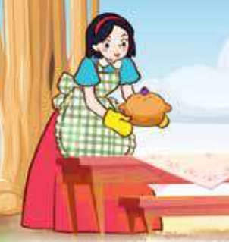
Riddle 3
How did Snow White cook?

Slide 48
Answer
She cooked very well.

Slide 49
Answer
Snow White and the seven dwarfs

Slide 50
Riddle 5
Talk about the main characters in this story.

Slide 51
Answer
They are the Ant and the Grasshopper.

Slide 52
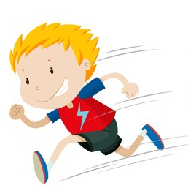
Riddle 6
How did the boy run?

Slide 53
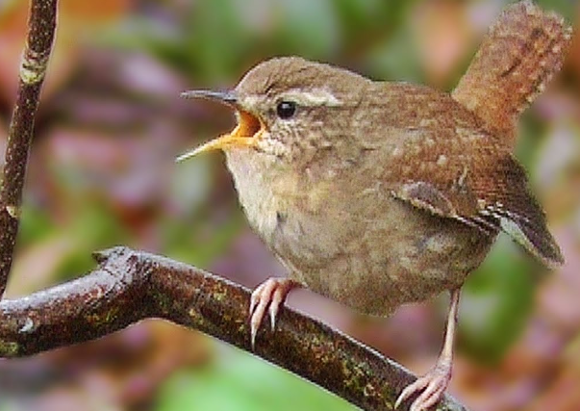
Answer
It sang beautifully.

Slide 54
Website: hoclieu.vn
Fanpage: https://www.facebook.com/tienganhglobalsuccess.vn/

